Slide 1
TIME SERIES PROJECT ON INSTAGRAM REACH FORECASTING
Prepared by Farooq Shaikh
Under The Guidance of
Mr. Rithik Raj

Slide 2
Introduction :
In today's digital age, social media platforms have become integral to businesses and individuals alike.
As one of the leading social media platforms, Instagram serves as a powerful tool for brand promotion and engagement.
Understanding and predicting trends in key metrics, such as "Instagram reach," can significantly impact marketing strategies and overall business success.
Our project aims to harness the power of data analytics to predict future Instagram reach, providing valuable insights for optimizing content strategies, scheduling posts, and enhancing online presence.

Slide 3
Dataset :
Dataset consists of 365 rows, that covers a period of time with daily observations from (2022-04-01 to 2023-03-31) and 2 columns.
Columns in the dataset are:
Date: It contains timestamps and date values corresponding to each entry in the dataset.
Instagram reach: Refers to the total number of unique users who have seen a particular post or content on Instagram during a specific time period.
Forecasting the Instagram reach is the process of predicting the number of people that an Instagram post, story, or other content will be reached, based on historical data and various other factors.

Slide 4
Objective :
Develop accurate and reliable time series forecasting models to predict future Instagram reach.
Understand and capture underlying patterns, seasonality, and trends in the data.
Analyze and understand any seasonality in Instagram reach, such as recurring patterns based on days of the week, months, or specific events.
Use forecasting results to make data-driven decisions, ultimately improving the return on investment (ROI) of marketing efforts on Instagram.

Slide 5
Data Exploration
Data exploration is a crucial step in any Time Series Project as it helps in understanding the structure, patterns, and potential challenges within the dataset.
Data exploration steps includes importing the libraries, loading the dataset and initial data examination.

Slide 6
Data Preprocessing
Data preprocessing is another important step in a time series project as it ensures that the data is clean, well-structured, and ready for analysis.
This step includes :
Handling missing values: Depending on the dataset, imputing missing values using mean, median, or other methods.
Converting Date to DateTime Format: Ensure that the 'Date' column is in datetime format, which is essential for time series analysis.
Set Date as Index: Set the 'Date' column as the index, which is necessary for time series analysis.

Slide 7
Time Series Analysis Technique:
Time series analysis involves exploring and understanding the temporal patterns, trends, and seasonality present in the data.
Some of the Time Series Analysis techniques are:
Time Series Decomposition: It involves decomposing the time series into its components: trend, seasonality, and residual. This helps in understanding the underlying patterns.
ARIMA (AutoRegressive Integrated Moving Average): ARIMA models helps to capture autoregressive and moving average components in the time series data.
SARIMA (Seasonal AutoRegressive Integrated Moving Average): It is an extension of ARIMA that can account for seasonal patterns in the data. It works by determining the appropriate order parameters (p, d, q) and seasonal order parameters (P, D, Q, m).

Slide 8
Time Series using SARIMA
Time series forecasting using the Seasonal Autoregressive Integrated Moving Average (SARIMA) model involves predicting future values of a time-dependent variable, such as Instagram reach, based on its historical patterns and trends.
Steps involves in SARIMA are:
Plot Autocorrelation Function (ACF) and Partial Autocorrelation Function (PACF) to identify potential orders for the SARIMA model.
Determine the appropriate order parameters (p, d, q) and seasonal order parameters (P, D, Q, m).
Fit the SARIMA model on the training set using the selected order parameters.
Make predictions on the testing set.

Slide 9
Forecasting
Forecasting using the Seasonal Autoregressive Integrated Moving Average (SARIMA) model involves predicting future values of a time series variable, such as Instagram reach, by considering its past values, trends, and seasonality.
For content creators and anyone using Instagram professionally, predicting the reach can be valuable for planning and optimizing their social media strategy.
By understanding how their content is performing, creators can make informed decisions about when to publish, what types of content to create, and how to engage their audience.
It can lead to increased engagement, better performance metrics, and ultimately, greater success on the platform.

Slide 10
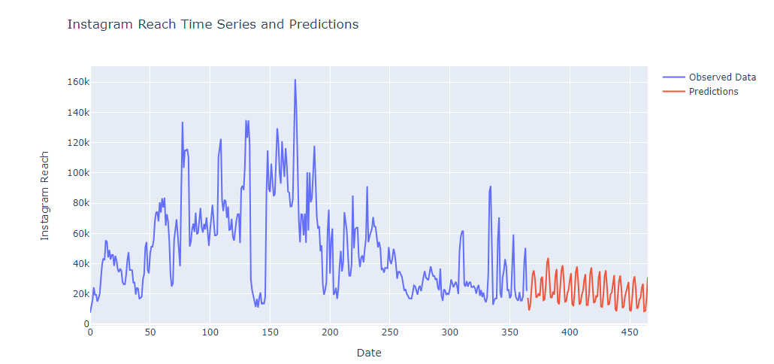
Forecasted Plot

Slide 11
Conclusion
In conclusion, our project on Instagram reach forecasting provides valuable insights and actionable recommendations for optimizing content strategy and enhancing social media marketing efforts.
It helps to Identify and capture seasonal patterns in Instagram reach, allowing for strategic planning around peak engagement periods.
Analyzed trends in Instagram reach to understand long-term growth or fluctuations, aiding in the development of sustainable content strategies.
We have Developed and trained a SARIMA model that demonstrated forecasting capabilities for predicting future Instagram reach.

Slide 12
Thank You

